Slide 1

PREDICTING TOP MOVERS IN STOCK MARKET USING MARKET NEWS SENTIMENT ANALYSIS AND RNN-LSTM
CIS.731 M001 FALL20 ARTIFICIAL NEURAL NETWORKS
ADITYA TORNEKAR
ABHIRAJ SINGH

Slide 2
INTRODUCTION
Goal of the project: To predict whether a stock is Top-Mover or not using Market Sentiment Analysis
Top Mover: Highest percentage change is stock price
RNN-LSTM models for used prediction

Slide 3
DATA UNDERSTANDING
Yahoo Finance Stock Market Data
Kaggle: Daily News For Stock Market Prediction
Standardization
Train-Test Split
Reshape for model consumption

Slide 4
SENTIMENT SCORE GENERATION
VADER SENTIMENT SCORES
EXPERTISE SENTIMENT SCORES
Positive, Negative, Neutral & Compound Sentiment scores
Kaggle Human annotated Data

Slide 5
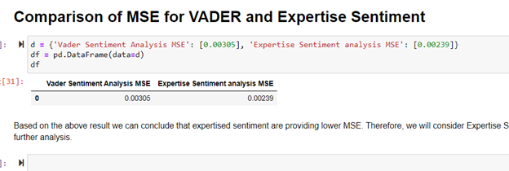
SENTIMENT SCORE EVALUATION
VADER SENTIMENT SCORES
EXPERTISE SENTIMENT SCORES
Discarded looking at the below MSE results
Used for further analysis and experimentation

Slide 6
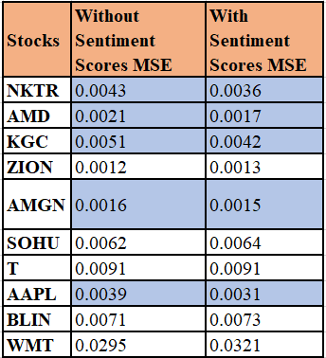
MSE RESULTS: SENTIMENT SCORE VS WITHOUT SENTIMENT SCORE
Blue highlighted stocks showed better results using Sentiment scores

Slide 7
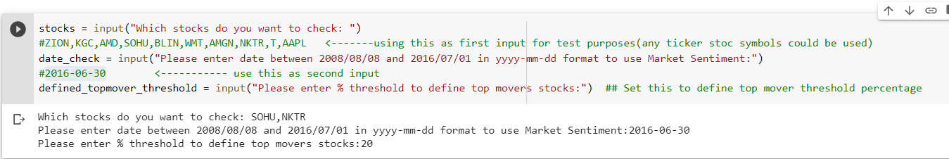
DYNAMIC USER INTERACTION
Users need to input below three variables:
List of stocks to be checked
Date Range
Top Mover Percentage Threshold

Slide 8
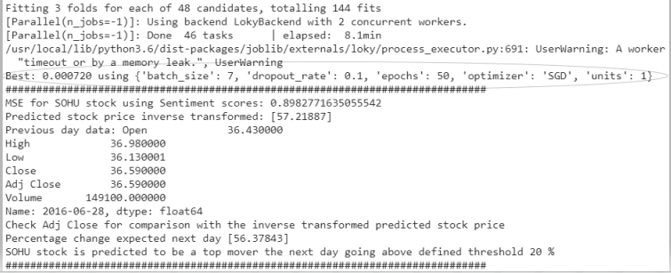
HYPER – PARAMETER TUNING
Tuning hyper-parameters:
Batch-size
Dropout-rate
Epochs
Optimizer
LSTM units

Slide 9
FUTURE WORK DISCUSSION
Usage of Dynamic Real Time Data
Tuning Hyper – parameter flexibility
Graphical User Interface for better user interaction
Better Sentiment Score generation module

Slide 10
CONCLUSION
We used market sentiment data to understand and predict the Top-Movers stock (highest % change in stock price)
Observed results indicated using market sentiment data was useful for prediction model

Slide 11
REFERENCES
Data: Sun, J. (2016, August). Daily News for Stock Market Prediction, Version 1. Retrieved [12-08-2020] from https://www.kaggle.com/aaron7sun/stocknews
Presentation Template: www.free-power-point-templates.com
Overall project references:
https://developer.twitter.com/en/docs/api-reference-index
https://www.selenium.dev/documentation/en/webdriver/
https://finance.yahoo.com/
https://medium.com/@jouneidraza522/yahoo-finance-api-to-get-stocks-tickers-data-in-python-c49820249a18
https://towardsdatascience.com/stock-news-sentiment-analysis-with-python-193d4b4378d4
https://robinhood.com/collections/top-movers
https://www.fool.com/investing-news/
https://towardsdatascience.com/how-to-label-text-for-sentiment-analysis-good-practises-2dce9e470708
https://towardsdatascience.com/a-new-way-to-sentiment-tag-financial-news-9ac7681836a7
https://www.researchgate.net/publication/326242364_Sentiment_Analysis_in_the_Light_of_LSTM_Recurrent_Neural_Networks

Slide 12
THANK YOU

